Slide 2
NJZIP Help Desk – Rutgers VTC
The Voorhees Transportation Center is working with NJEDA to staff a new NJZIP “help desk”
Purpose: To assist purchasers with the application process and provide assistance with planning for electric vehicle ownership.
Live information sessions
Resource website
Telephone or Text for personalized help

Slide 3
How to reach us
Website: https://vtc.rutgers.edu/njzip/
Email: njzip-help@ejb.Rutgers.edu
Phone: 732-790-0663
Call or text!

Slide 4
Topics we cover:
Personalized Technical Assistance
Procedural Assistance
Determining which vehicles are best suited to meet the business’s needs;
Understanding the costs of purchasing and operating ZE MHDVs;
Identifying what charging infrastructure businesses may need to accommodate their electrification plans,
Fleet operation needs and behavior adaptation.
Navigating the application portal;
Securing businesses certifications and tax clearance certificates;
Understanding requirements for registering and insuring vehicles; and
Reviewing draft application forms for completeness and accuracy.

Slide 5
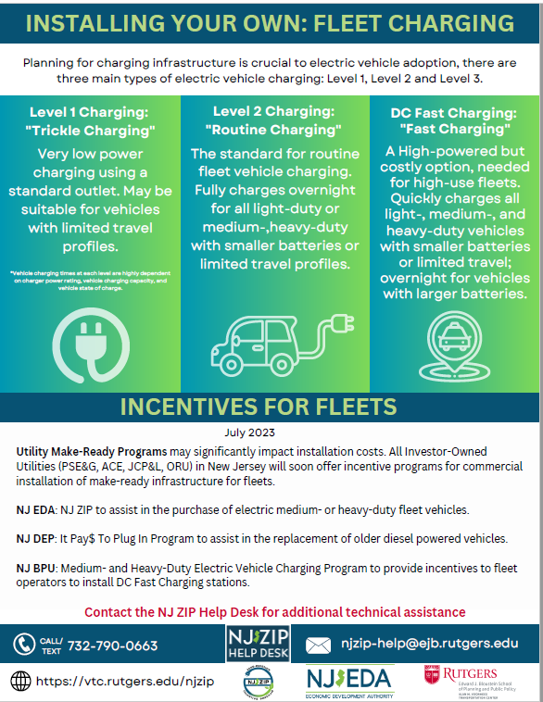
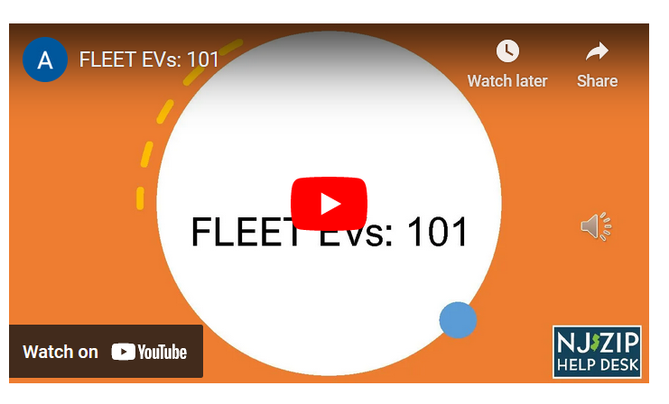
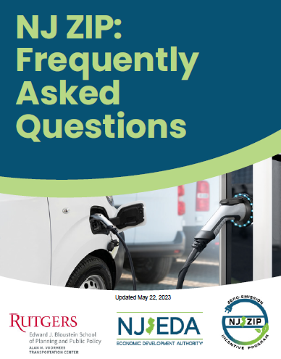
Some of our current resources

Slide 6
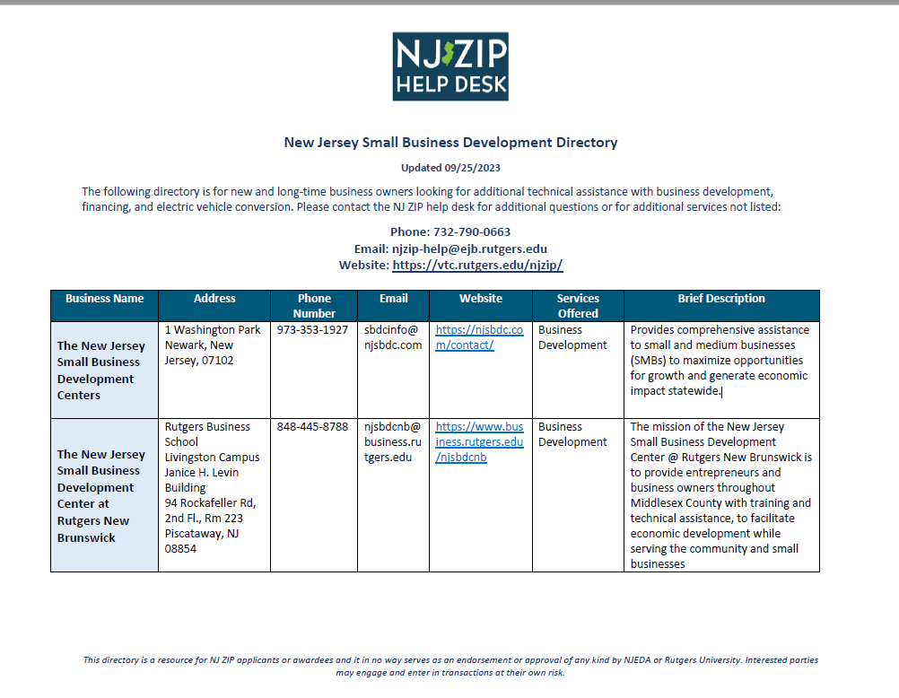
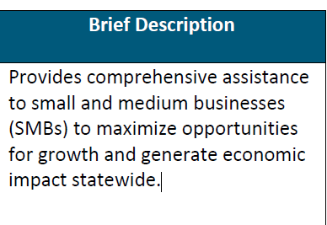
New Jersey Small Business Development Directory
A directory for business owners looking for additional technical assistance on business development, financing, and electric vehicle conversion.

Slide 7
Why this topic?
GNEC provides both technical assistance and financing for small businesses.
They are a unique nonprofit organization that is designed specifically to help with unique needs of small businesses, especially emerging businesses
The Help Desk has received many calls from purchasers who need gap financing or financing to modify the vehicle for their use.

