Slide 1
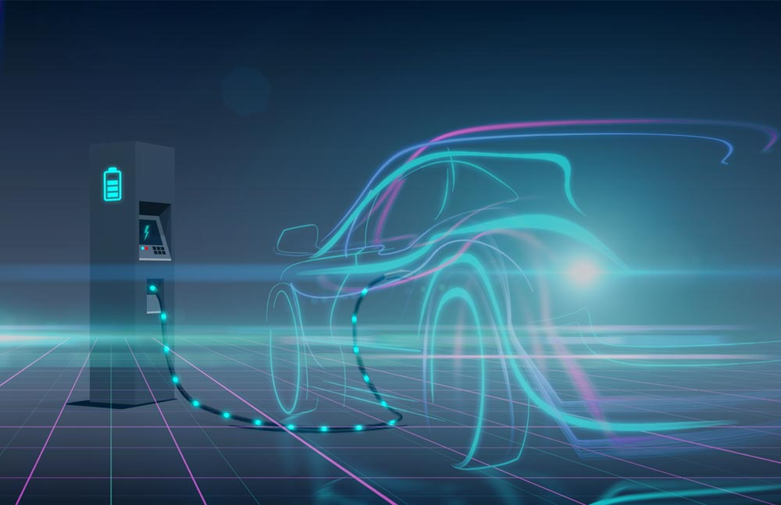
Powering Your Electric Vehicles
Partnering with your Electric Distribution Company
Dawn Neville, Manager Electric Transportation
November 16, 2023

Slide 2
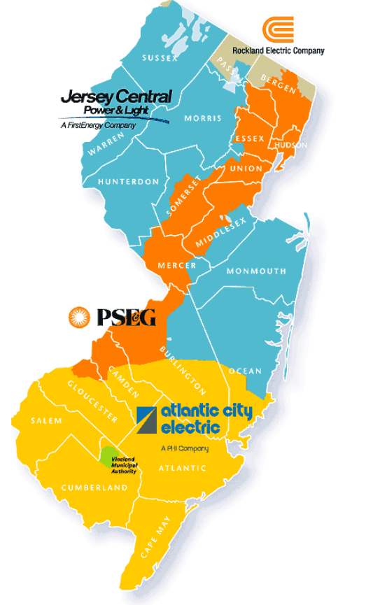
New Jersey Electric Distribution Companies
EDC | Acronym
Atlantic City Electric An Exelon Company | ACE
Jersey Central Power & Light A FirstEnergy Company | JCP&L
Orange & Rockland Rockland Electric Company | ORU / RECO
Public Service Electric & Gas | PSE&G
2

Slide 3
Common Industry Terms & Concepts
Key EV Acronyms
BEV | Battery Electric Vehicle
DCFC | Direct Current Fast Charger (Level 3)
ICE | Internal Combustion Engine
LDV | Light-Duty Vehicle
MHDV | Medium/Heavy-Duty Vehicle
PHEV | Plug-In Hybrid Electric Vehicle
PEV | Plug-In Electric Vehicles=BEV+PHEV
SOC | State of Charge (% charge of battery)
ZEV | Zero Emission Vehicle
EV Charging Basics
Charging Level | Speed | kW | Power Details | Range per time charged
Level 1 | Trickle | 1-2 | 110 Volts, Alternating Current | ~2-5 miles per hour
Level 2 | Fast* | 7-19+ | 240 Volts, Alternating Current | ~25 miles per hour
Level 3 - DCFC | Super Fast | 30+ | Typically, 150kW and climbing Direct Current | ~5 miles per minute (to 80% SOC) ~80% charged in 15-30 minutes
* Industry-accepted vernacular, takes ~3 to 4 hours to reach full charge
EV mile is 70% cleaner than ICE mile
PEVs are roughly 2x more efficient at converting primary energy into motion
PEVs do not consume electricity when idling
PEVs use re-generative braking
PEVs require minimal maintenance

Slide 4
MHDV Demand Analogies
23.5 MW
20+ MW
9-10 MW
9 MW
~1-5 MW
~5+ MW
Initial Service Requests
Sports Stadium
Transit Bus Depot
150 Buses¹
Empire State Building
Large Town
MD/HD Highway Plaza
10 x 350 kW +
10 x 2 MW Chargers²
Source: National Grid
NPR
West Coast Clean Transit Corridor Initiative Final Report
Design idea borrowed from this original ACEEE report, p. 34: www.aceee.org/research-report/t2102
Notes:
13 NJ transit depots

Slide 5
EDC Electric Vehicle Programs
Light Duty Vehicles

Slide 6
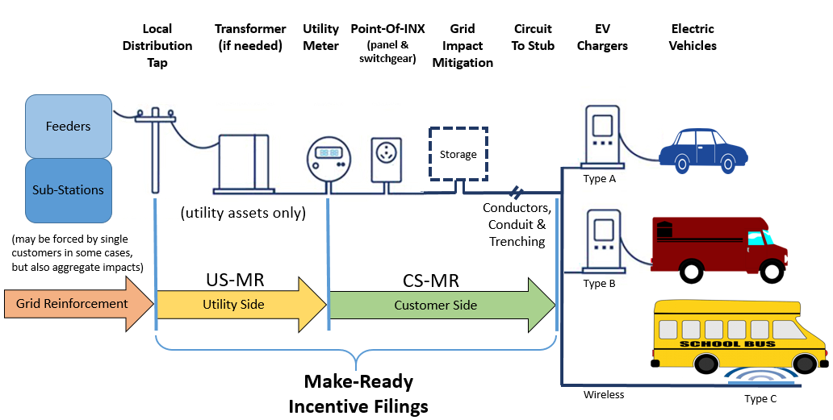
Understanding “Make-Ready”
Notes:
Shared responsibility model

Slide 7
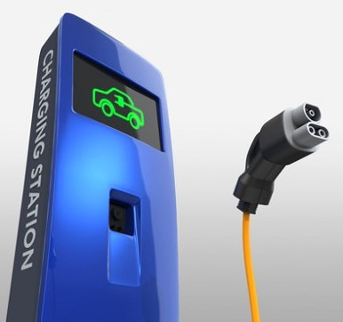
PSE&G Electric Vehicle Program
Investment $166M ~6 Year Program
Development of smart charging infrastructure to facilitate EV adoption across a broad range of customers and segments
Residential Smart Charging |  | Level 2 Mixed Use Commercial Charging |  | Public DC Fast Charging
Single Family Homes |  | Multi-Family, Government & Publicly Accessible |  | Travel Corridors & Community Locations
$80M Investment | 40,000 chargers | $35M Investment | 875 sites ~3,500 chargers | $45M Investment | 300 sites ~1,200 chargers
Incentives include*: Up to $1,500 toward Customer Side Make-Ready (CSMR) costs associated with the installation of a residential Level 2 charger Up to $5,000 Utility Side Make-Ready costs for utility service upgrades (if needed) Credit on charging during off-peak periods to help lower your bill |  | Incentives include*: Up to $30,000* toward Customer Side Make-Ready (CSMR) costs associated with the installation of commercial Level 2 chargers Up to $10,000 Utility Side Make-Ready costs for utility service upgrades (if needed) *Note: the incentive is based on the number of chargers installed, offering up to $7,500 per charger installation for up to four chargers per site |  | Incentives include*: Up to $100,000** per site for Customer Side Make-Ready (CSMR) costs associated with the installation for DCFC chargers Up to $50,000 Utility Side Make-Ready costs for utility service upgrades (if needed) Demand Charge Rebates to help lower your electricity bill **Note: the incentive is based on the number of chargers installed, offering up to $25,000 per charger installation for up to four chargers per site
Expected Benefits
an electric mile is
70%
cleaner than an average mile fueled by gasoline
14
million metric tons of CO₂ avoided through 2035
Mitigation of
EV market barriers
&
reduction in range anxiety
270
direct clean energy jobs
Current Status: 20,015*
(45%)
Advances
NJ clean energy and EV goals
Goal: 44,500
EV Chargers Installed
*Includes charger application pipeline
7

Slide 8
Utility EV Program Comparison
Program Element | ACE | JCP&L | ORU / RECO | PSE&G
Total Investment | $15M | $28.6M | $5.88M | $166M
Residential Smart Charging | $1.5M | $5.14M | $1.9M | $80M
Mixed Use Commercial L2 | $7.3M | $8.66M | $3.73M | $35M
DCFC Public Charging | $6M | $14.84M | N/A | $45M
IT Investment | N/A | N/A | $0.05M | $6.2M
Education and Outreach | N/A | N/A | $0.12M | N/A
O&M Expense | $5.9M | $11.24M | $1.72M | $39M
Total | $21M | $40M | $7.6M | $205M
Date Approved | 02/14/2021 | 06/09/2022 | 10/12/2022 | 01/27/2021
Program Length | 6 Years (thru 2026) | 4 Years (2022-2026) | 4 Years (2022-2026) | Not Stipulated (~6 years)

Slide 9
Electrifying Your Fleet? What To Consider When Talking To Your Utility
There are several important factors to consider when electrifying your fleet. Talking to your utility early and often can eliminate a number of potential pitfalls down the road as you progress through your electrification journey.
Choosing The Right Charging Infrastructure For Your Fleet
It is critical to know the average daily energy the vehicles will need for your business operations and the available time(s) the vehicle can recharge.
Start with your vehicle manufacturer to estimate your EV’s energy consumption.
To talk to someone on the utility’s EV team, please see contacts below.
Utility Service Upgrade
Adding EV charging infrastructure may require your utility to upgrade its facilities to support the new power requirements.
Before beginning your project, please contact your utility, see contacts below.
Electric Rates and EV Charging Impacts
The power rating of your charger will directly influence your monthly utility bill.
The cost of electricity depends on the fleet, charging profile, and how you manage it.
To understand more about the impacts of electrical demand, please see contact below.
9

Slide 10
Contact List for EV-Related Information & Service Upgrades
Utility | Utility-Specific EV Team | Utility Service Upgrade | Electric Rates and EV Charging Bill Impacts
ACE | For general Evsmart program questions email: Evsmart-ACE@ICF.com Or Email: Evsmart-ace@atlanticcityelectric.com | Visit Service Requests page or call the appropriate local engineering office for your location at: Cape May: 609-463-3823 Glassboro District: 856-863-7906 Pleasantville District: 609-645-4667 Winslow District: 856-753-2808 | Email: Evsmart-ace@atlanticcityelectric.com
JCP&L | Visit: New Jersey EV Driven (firstenergycorp.com) | Visit: Establish or Upgrade Service | Email: NJEVDriven@firstenergycorp.com
ORU / RECO | Email: recoev@oru.com | Visit: https://www.oru.com/en/small-medium-sized-businesses/project-center | Email: recoev@oru.com
PSE&G | Email: PSEG-Electric.Vehicles@pseg.com | Visit: Upgrades and New Installations Or Email: PSEG-Electric.Vehicles@pseg.com | Email: PSEG-Electric.Vehicles@pseg.com
Talk to your utility
“Early and Often”

Slide 11
Typical Construction Timelines
Issues that may impact schedule:
Supply chain delays
Site operations
Easements
Permitting
Amperage and load requested
Distance to available capacity
Distribution Transformer only
Averages* 6 months to 1 Year
Transformer and capacity
Averages* 1 to 3 Years
Distribution Substation
Averages* 5 to 7 Years
*Individual site timelines can vary significantly
11

Slide 12
Questions??

